Slide 1

University Avenue
NM 101 Multimodal Project
Public Meeting
November 18, 2025
Zia Middle School LC 00290R

Slide 2

Construction Team
Aaron Chavarria, District 1 Engineer, NMDOT
Harold Love, Assistant District 1 Engineer Technical Support, NMDOT
Ryan Tafoya, Project Manager, NMDOT
Andrew Guerra, District 1 Resident Engineer, NMDOT
Earl Franks, Assistant District 1 Engineer Construction, NMDOT
Nick Villalobos, Project Manager, La Calerita Construction
Toby Villalobos, Project Superintendent, La Calerita Construction
Ami Evans, District 1 Public Information Officer, NMDOT
Patti Watson & Gareth Bill, Communications Contractor, CWA Strategic
Communications

Slide 3
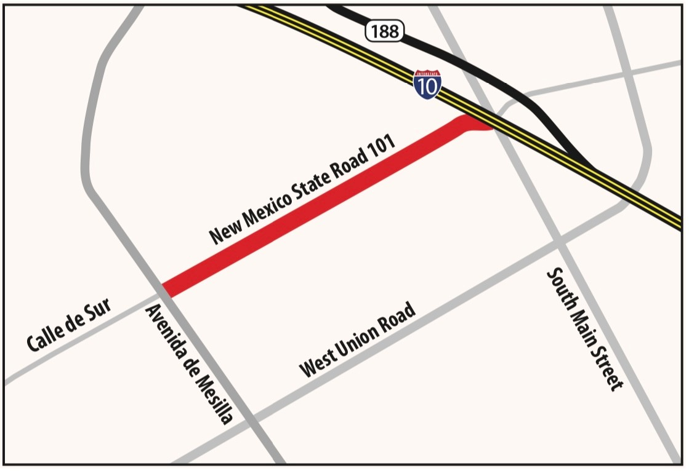
Project Description & Limits
Length of Project: 1.419 Miles
Begins at Avenida de Mesilla
Extends to South Main Street

Slide 4
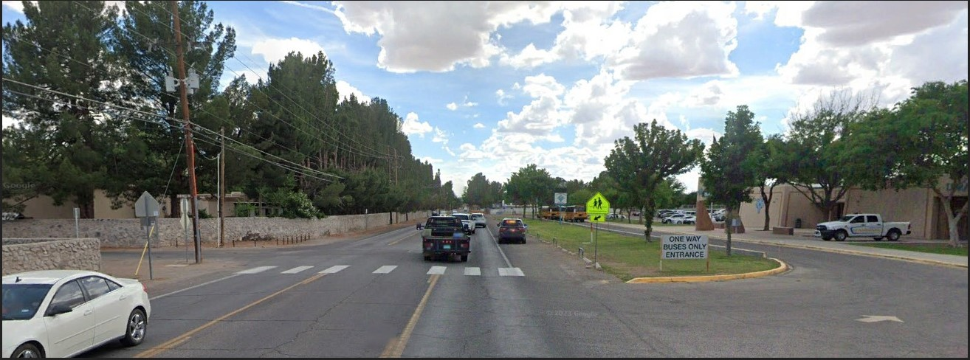
Project Purposes
Widen University Avenue
Construction of new curb, gutter and sidewalks
Construction of multi-use path
Construction of storm drain
Permanent signs and roadway striping
New lighting
Railroad crossings

Slide 5
Anticipated Construction Phases and Traffic Impacts
Project will be built in four phases, and some phases will have sub-phases.
Construction begins Tuesday, November 26, 2024 and is anticipated to last about
23 months, through fall 2026.
Regular Work Hours will be Monday-Friday 7am-4:30 pm during Standard Mountain Time.
Regular Work Hours will be extended during Daylight Savings Time.
Contractor may work additional hours or on weekends as needed.
All construction is scheduled weather permitting and is subject to change without notice.

Slide 6
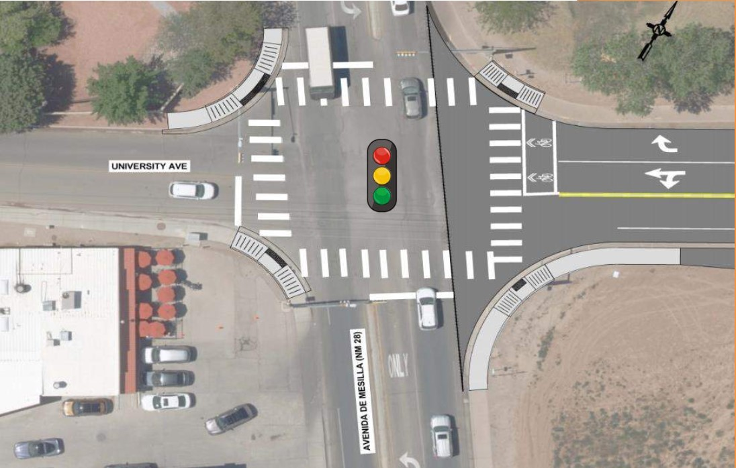
Phase 1A – Mesilla Intersection Ramps
Phase 1A, 1B and 1C are expected to last through May 2025
Crews will:
Install signs at the beginning and end of project and
two variable message signs within the project.
Build the Avenida de Mesilla intersection ramps at University.
Install temporary traffic signals.

Slide 7
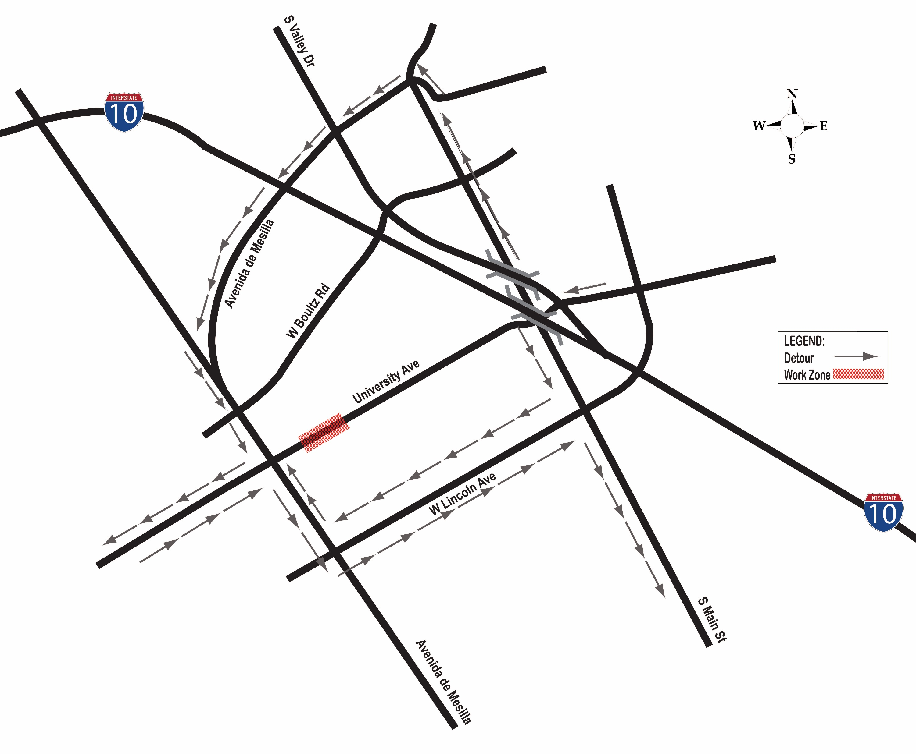
Phase 1B – Road Closure at Laguna Lateral
Crews will:
Construct entire Laguna Lateral hydraulic structure
and irrigation channel and storm drain pipes.
All traffic routes will be closed across the Laguna Lateral.
Detour will be in place along Avenida de Mesilla, West Lincoln Avenue and South Main Street.

Slide 8
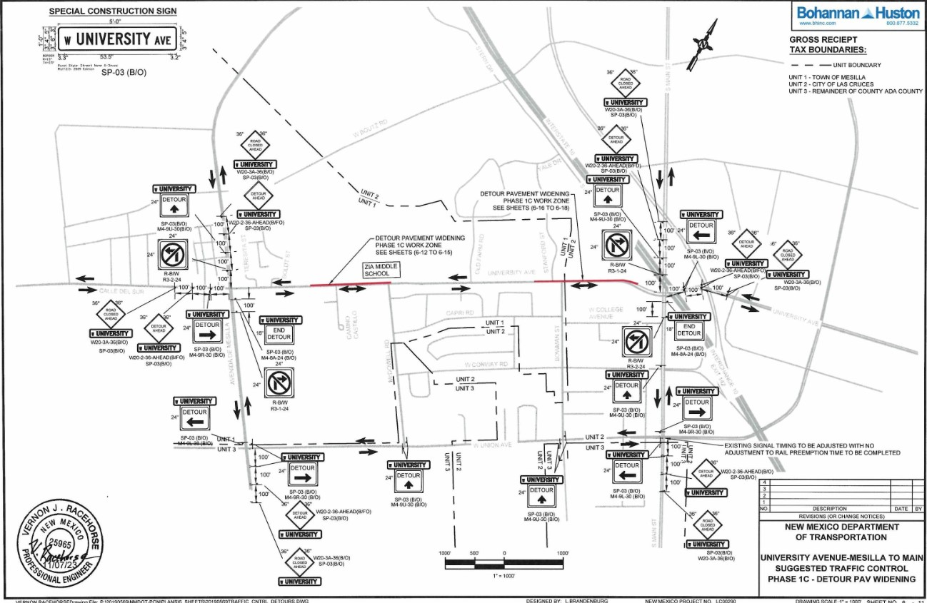
Phase 1C – North Detour Pavement Widening
Crews will:
Install detours to begin widening part of the northern portion of University.
Two-way traffic will remain on existing lanes during nonworking hours.
A flagger will be on-site as needed to direct one-way traffic during paving operations.
A detour will be in place and will be provided in advance.

Slide 9
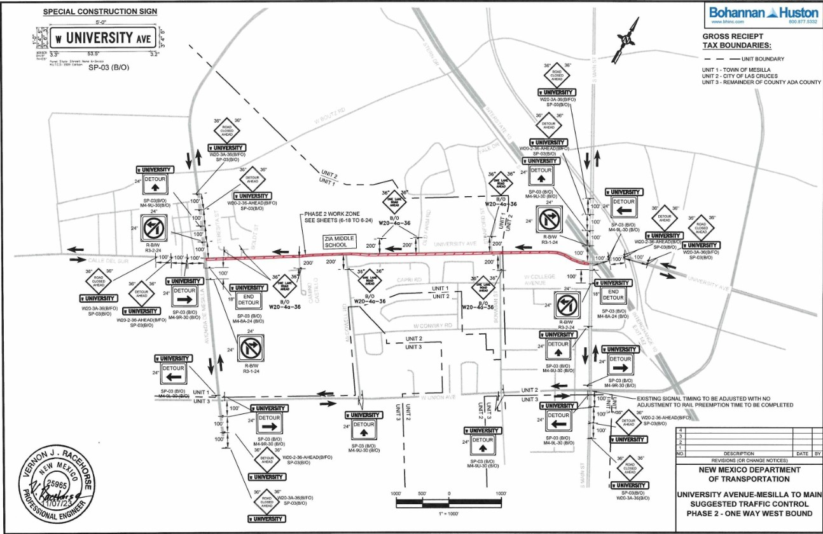
Phase 2 – South of Centerline Construction
This phase is expected to last through November 2025.
Crews will:
Build all remaining infrastructure south of the centerline from the beginning of the project to the railroad
Build and connect college lateral upgrades and build half of the perpendicular storm drainage pipeline.
All eastbound traffic on University will be detoured to McDowell and Bowman.

Slide 10
Phase 3A – North of Centerline Construction
Phase 3 is expected to last from November 2025 to Summer 2026.
Crews will:
Install asphalt pavement north of the construction centerline from the beginning of the project to the railroad and will build and connect the remaining storm drainage pipeline.
Eastbound traffic on University will be open and westbound traffic will be closed with a one-way eastbound detour.
Detours will be to Teresita and Boldt Street and to Old Farm and Stanford to build each turnout.

Slide 11
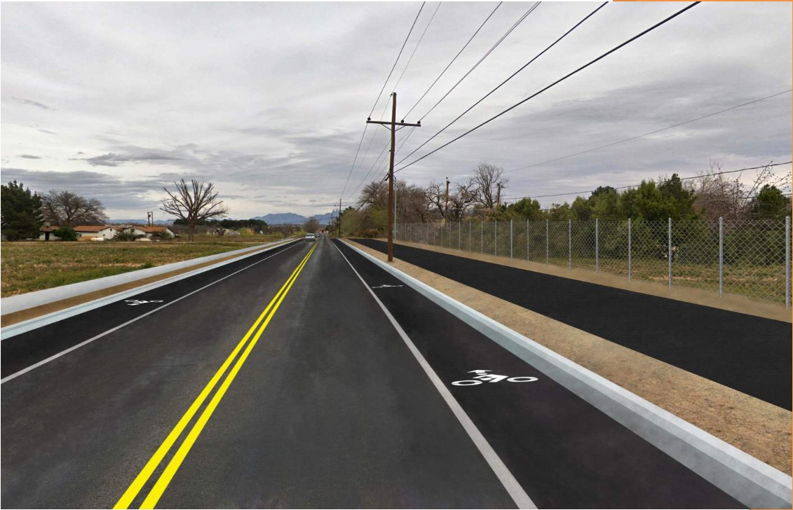
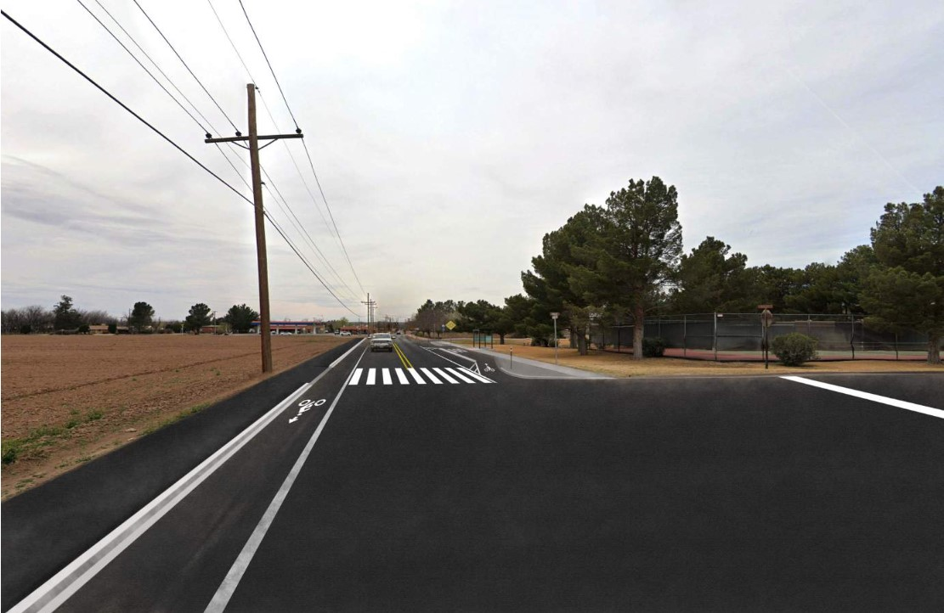
Phase 3A – North of Centerline Construction (Cont.)

Slide 12
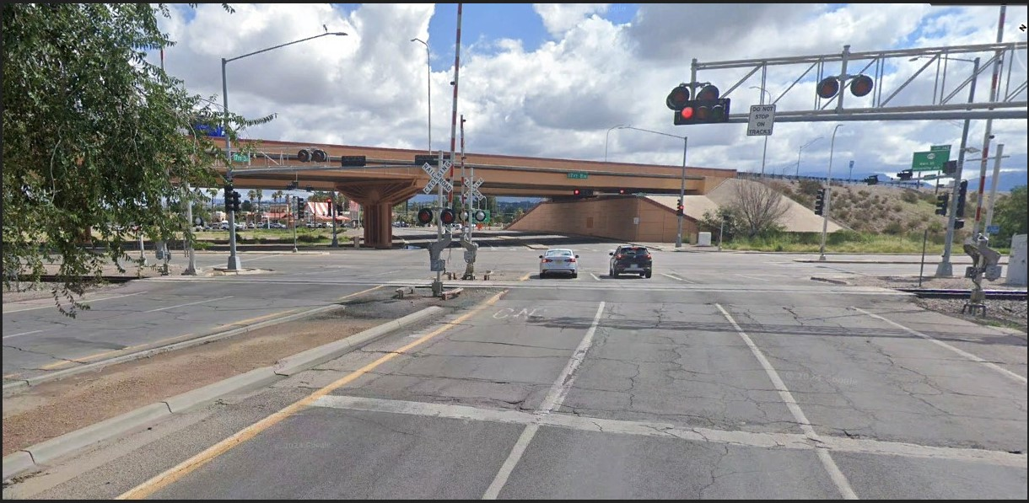
Phase 3B – Road Closure at Railroad Crossing
Crews will:
Build the infrastructure at the railroad, including ramps and signal operation.
All traffic will be closed from Bowman to Main Street with a detour.

Slide 13
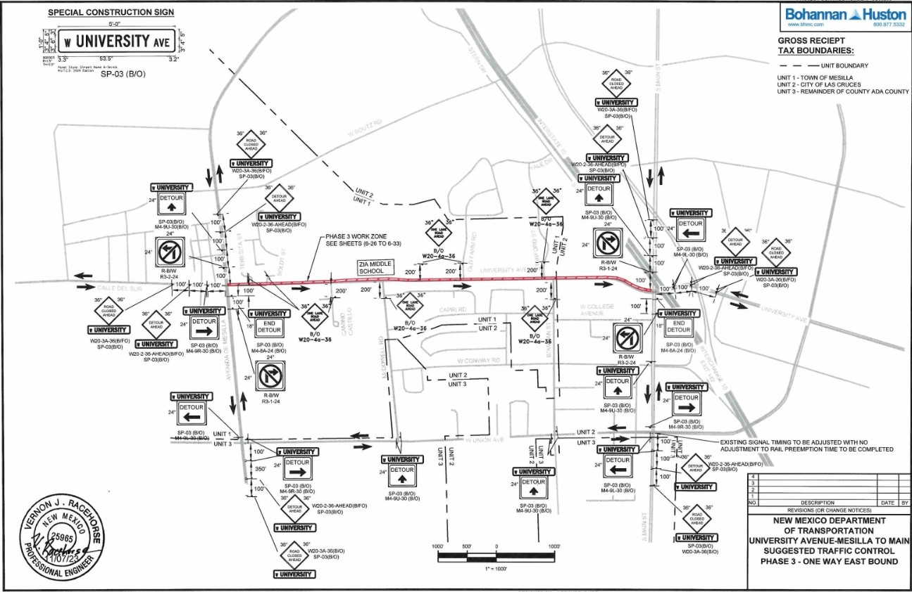
Phase 3C – Main Street Median Construction
Crews will:
Remove part of the median and rebuild the median nose.
Two-way traffic will be opened on University.

Slide 14
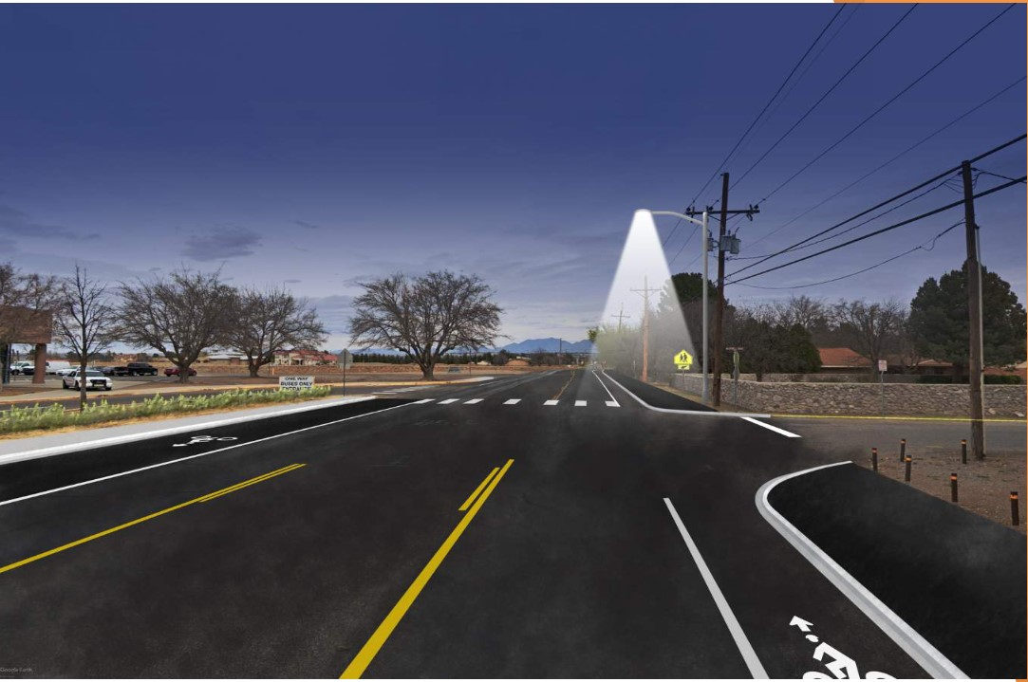
Phase 4 – Final Phase
Phase 4 is expected to last from summer to fall of 2026.
Crews will
Install any remaining asphalt pavement, finish striping the roadway and install permanent signage.
Temporary lane closures may be required.

Slide 15
Contacts for Concerns and Questions During Construction
Patti Watson, Communications Contractor, CWA Strategic Communications
505-245-3134 Office·505-269-9691 cell·1-800-687-3417
pattiw@cwastrategic.com
Gareth Bill, Communications Contractor, CWA Strategic Communications
505-245-3138 office·505-417-9989 cell· gareth@cwastrategic.com

Slide 16
Questions?

Slide 17
Stay in the loop during construction!
Contact pattiw@cwastrategic.com or gareth@cwastrategic.com to sign up for free construction updates via email.
Get real-time information at www.nmroads.com.

Slide 18
Thank You!

